Slide 1
Tapping Into the
Power of Top
Performing Boards

Slide 2
Mark Aydelotte
Assistant Vice Chancellor at the University of California, Irvine
Directed the marketing of a $1 billion comprehensive campaign for the university
…now at $900+ million.
>whew<

Slide 3
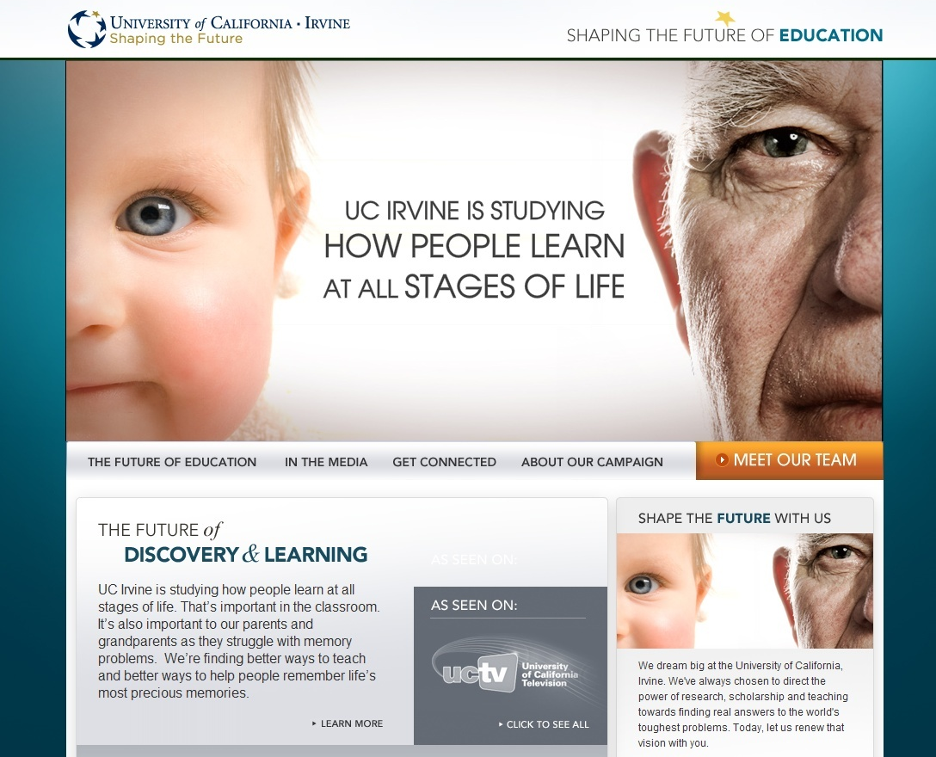

Slide 4
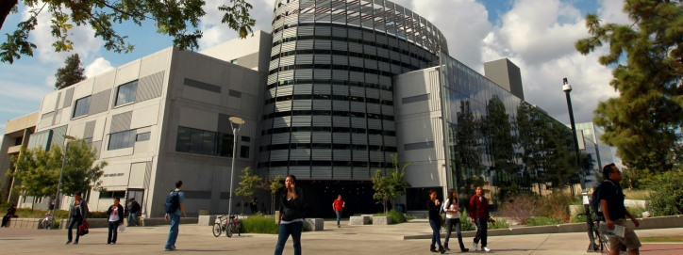
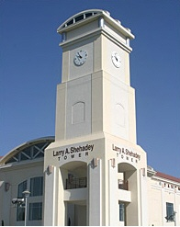
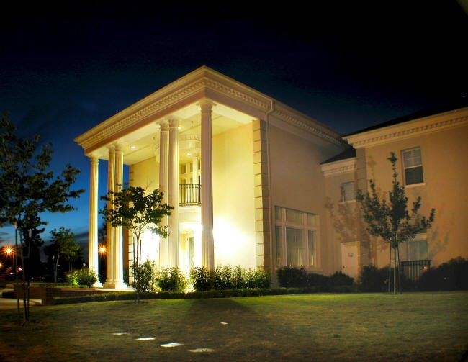
Fresno State

Slide 5
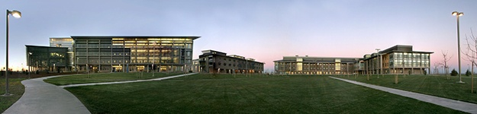



UC Merced
UC Office of the President
State Center Community Colleges
Mennonite Health Services

Slide 6
Goals for today
  Better understand major donors
  Learn ways to foster major gifts from boards, committees and advisory groups
  Learn a self-evaluation technique to effectively engage boards

Slide 7
What we need
Major donors who can and will give
Focus more time, energy and resources on donors who are at the top of the donor pyramid

Slide 8
Typical Development Activities
Annual Fund
Corporate Gifts
Foundations
Special Events
Major Gifts
Alumni Appeals
Planned Giving (Bequests, Trusts)
Social Media
Product Sales

Slide 9
Consider Giving Patterns
Individual Gifts $143.71 Billion 75.6%
Bequests $ 15.61 Billion 8.2%
Foundations $ 19.81 Billion 10.4%
Corporations $ 11.02 Billion 5.8%

Slide 10
The UC Irvine Study
We surveyed the top foundation leaders
Conducted through The Association of Governing Boards, CASE and development consultants
Test -- 600

Slide 11

Top Ten Attributes of Top-Performing Boards
1. Exceptional university leadership
2. Passionate, committed volunteers
3. Clear sense of responsibilities
4. Enterprising, effective professional
staff
5. In touch with academic enterprise

Slide 12
Attributes of Top-Performing Boards
6. Commitment to diversity
7. Inspired case for private support
8. Rich, deep culture of philanthropy
9. Rigorous performance culture
10. Commitment to strategic planning

Slide 13

Goal
To develop a self-evaluation tool to use in evaluating our board compared to other top-performing boards.

Slide 14
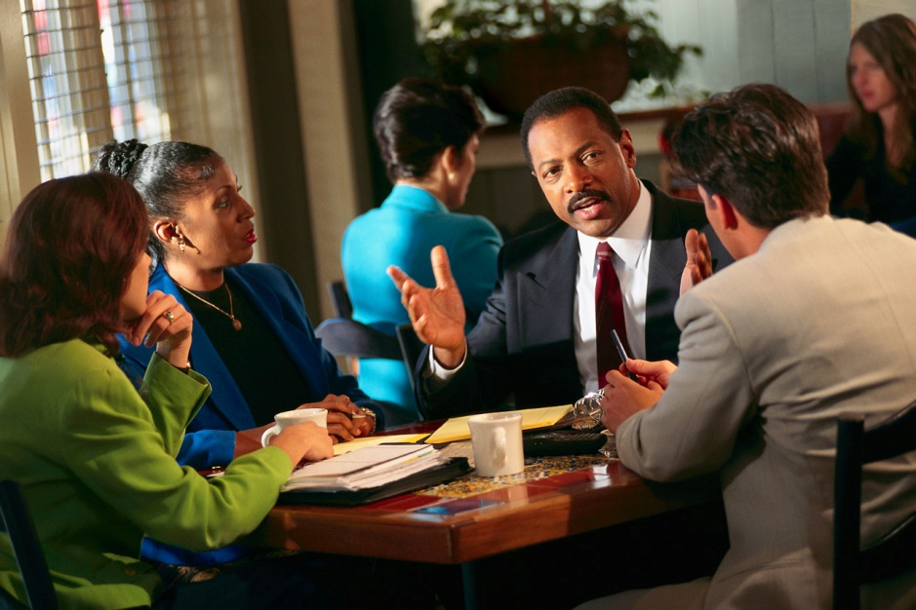
“The Discussion”
Spark “real” discussion with board leaders
Set realistic goals for philanthropy
Encourage thinking about their own giving

Slide 15
What are the attributes of top performing boards?
It depends

Slide 16

Is your board?
❑ Advisory
❑ Advocacy
❑ Philanthropic
❑ Governing
❑ All of the Above
❑ Other

Slide 17
Is your board?
❑ Mature
❑ Emerging
❑ Start-up

Slide 18
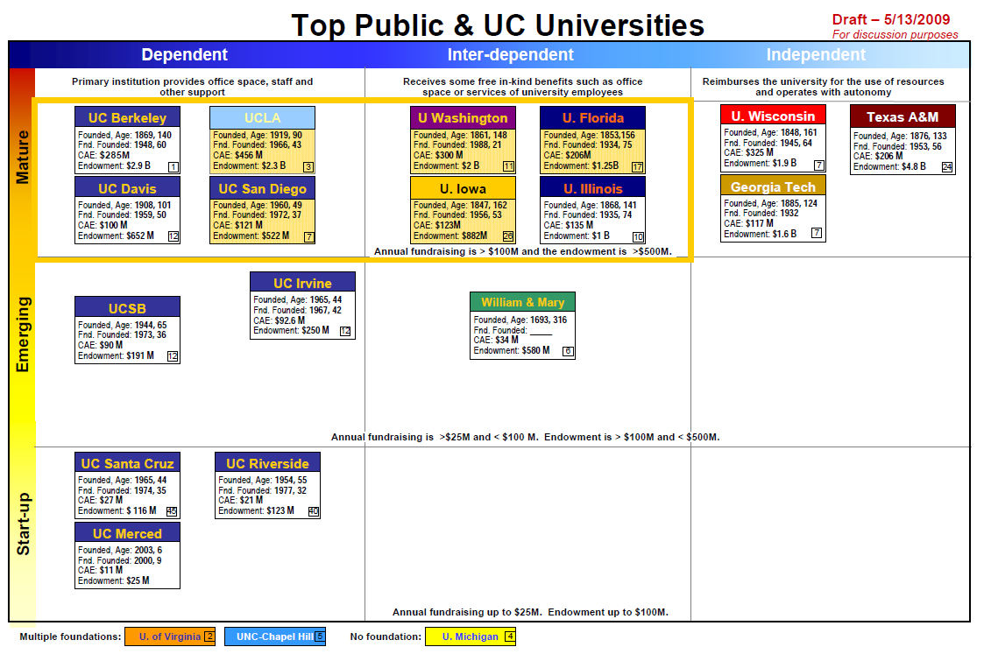

Slide 19
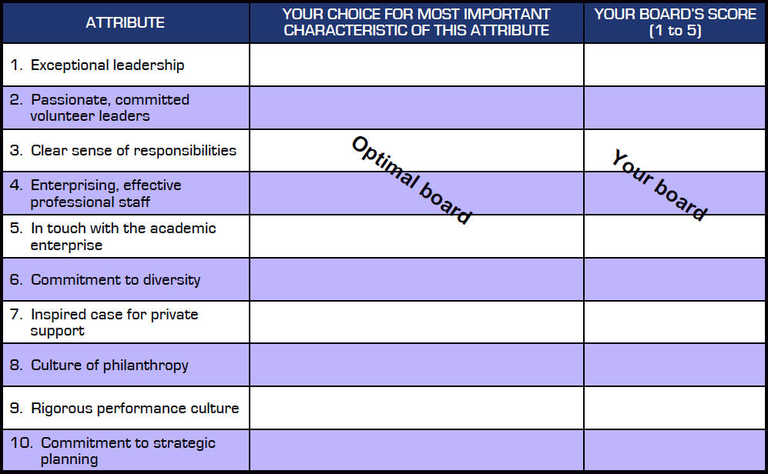
Attributes of Top-Performing Boards

Slide 20
Sample Attribute:
1. Exceptional university leadership
The optimal chancellor/president would exhibit
the following leadership characteristics:
1. Visionary
2. Inclusive – builds relationships – consensus builder
3. Focused – sense of urgency
4. Inspiring – communicator
5. Commitment to excellence – high standards
PARKING LOT
• Humble
• Sense of humor
• Patience
• Dynamic
• Embracing
• Long-term view
• Belief in partnerships

Slide 21

2. Passionate, committed volunteers
The optimal board member would …
    ▪ Provide philanthropic leadership
    ▪ Enthusiastically support the mission & vision
    ▪ Ensure ethical integrity
    ▪ Support the executive director
    ▪ Enhance the organization’s public standing

Slide 22
3. Clear sense of responsibilities
The optimal board would …
    ▪ Set and clarify the mission and purpose of the board
    ▪ Support the executive director
    ▪ Provide input on programs
    ▪ Ensure good management
    ▪ Relate organization to community and community to organization

Slide 23

4. Enterprising & effective professional staff
The optimal professional staff member is …
    ▪ Invested in the organization
    ▪ Value-based and principle-centered
    ▪ Performance-driven
    ▪ Comfortable both leading teams and being a team member
    ▪ Inspirational

Slide 24
5. In touch with the mission
The optimal board would …
    Be aware of programs and ensure that priorities are being met
    Engage with major constituencies (in concert with the director)
    Ensure mission accuracy
    Remain informed about issues and challenges
    Participate in the strategic planning process

Slide 25
6. Commitment to diversity
The optimal board would …
    ▪ Have leadership, membership, and professional staff reflecting the diversity of the organization and the community
    ▪ Produce an annual report that highlights diversity
    ▪ Feature board presentations and events that strategically incorporate diversity
    ▪ Offer diversity training for managers and staff
    ▪ Create programs and awards that recognize and celebrate diversity

Slide 26
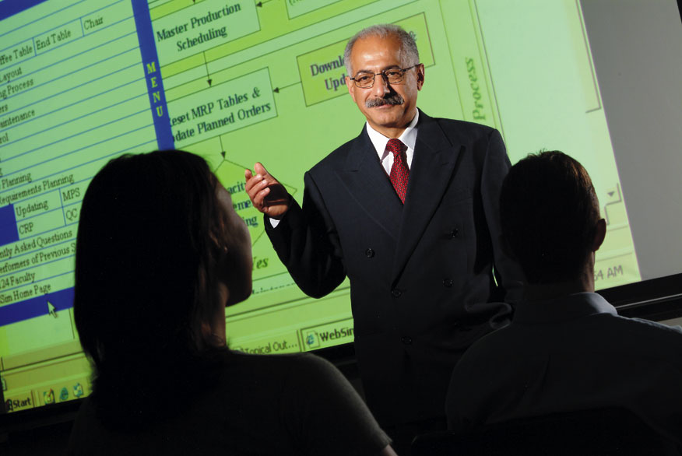
7. Inspired case for private support
The ideal case for private support would be …
    ▪ Visionary and bold
    ▪ Unique and distinctive
    ▪ Inspirational
    ▪ Impactful
    ▪ Believable

Slide 27

8. Culture of philanthropy
The optimal board would have …
    ▪ Philanthropy as a core part of its mission
      ▪ Board members providing philanthropic leadership
    ▪ Consecutive years of philanthropic success (long history)
      ▪ Full range of giving programs (events, legacy, etc.)
    ▪ Broad-based constituent giving

Slide 28
9. Rigorous performance culture
The optimal board would …
    ▪ Focus on continuous improvement and metrics
    ▪ Commit to fact-based analysis and decision-making
    ▪ Challenge existing ideas
    ▪ Be willing to learn from peers (best practices)
    ▪ Have a vital sense of urgency

Slide 29
10. Commitment to strategic planning
Approves and embraces the planning process
Ensures that all constituencies are involved and fairly heard
Ensures a balance among scale and scope, innovation and constraints
Gives permission to eliminate, cut back or say no
Contributes to envisioning and prioritizing as well as succession planning

Slide 30
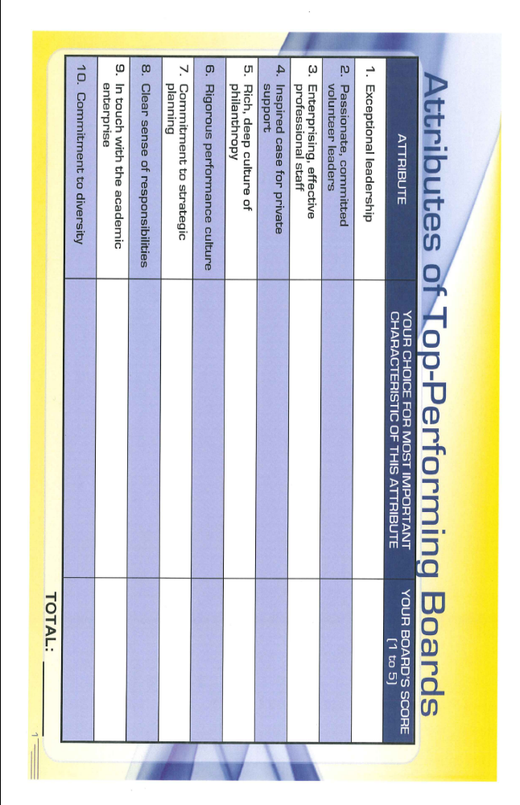

Slide 31
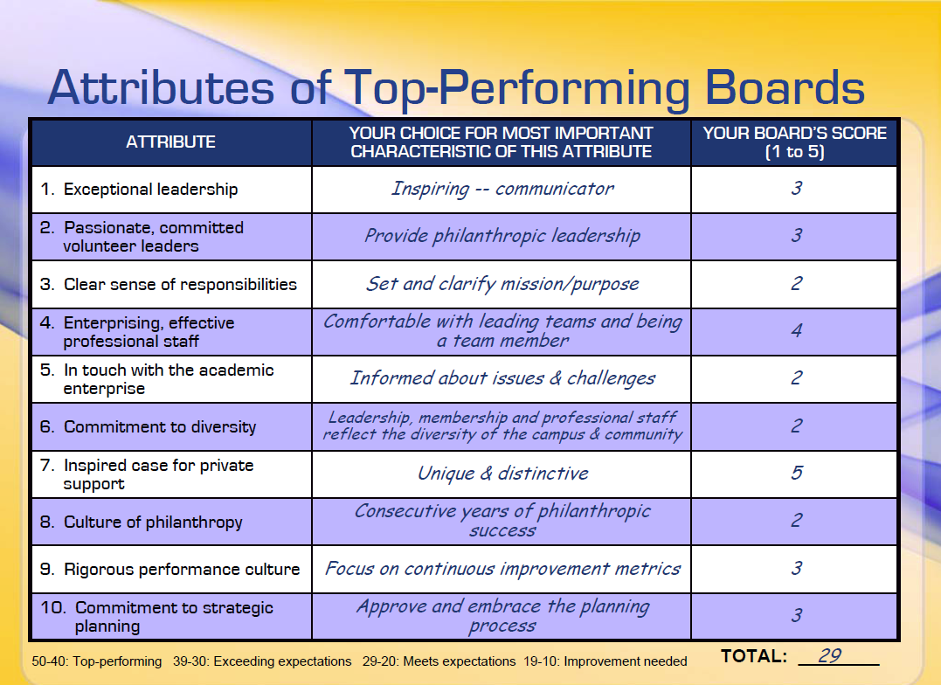
10. Commitment to strategic planning
The optimal board would …
    ▪ Approve and embrace the planning process
    ▪ Ensure that all constituencies are involved and fairly heard
    ▪ Ensure a balance among scale and scope, innovation and constraints
    ▪ Give permission to eliminate, cut back or say no
    ▪ Contribute to envisioning and prioritizing as well as succession planning

