Slide 1
WACUBO
Advancement is Everybody’s Business…

Slide 2
Mark Aydelotte
Assistant Vice Chancellor at the University of California, Irvine
Directed the marketing of a $1 billion comprehensive campaign for the university
….112,887 donors.
…$984+ million.
>whew<

Slide 3
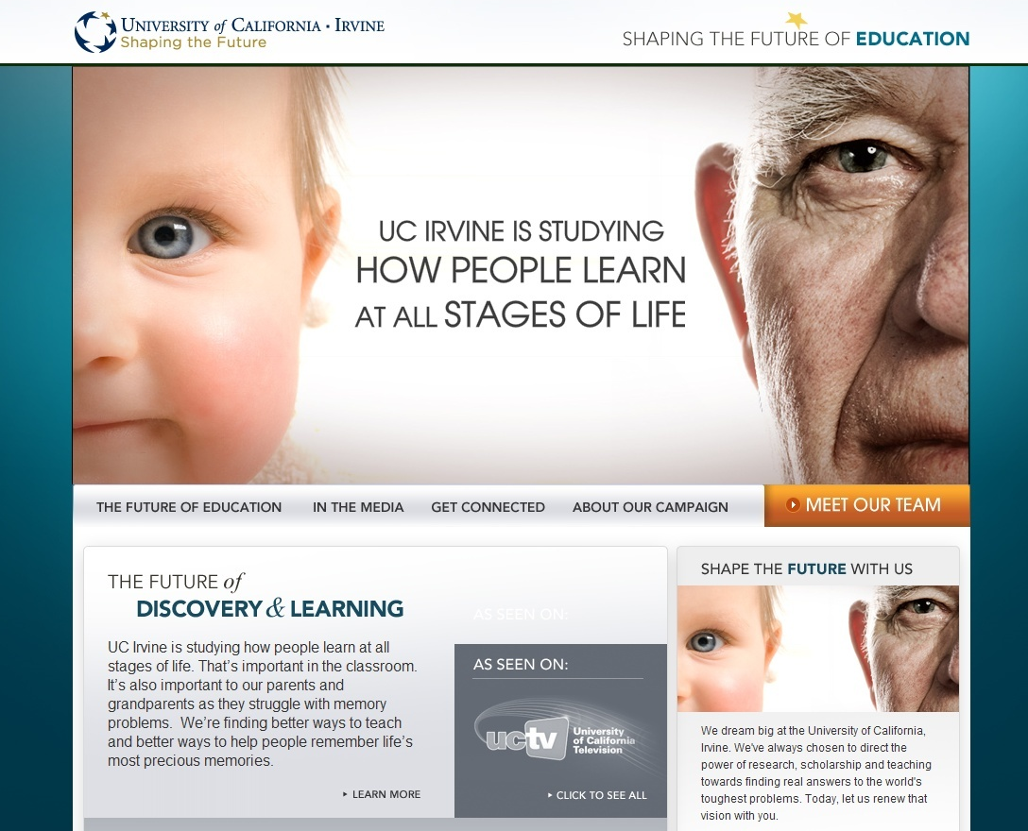

Slide 4
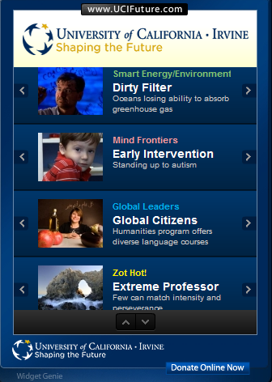
www.UCIFuture.com

Slide 5
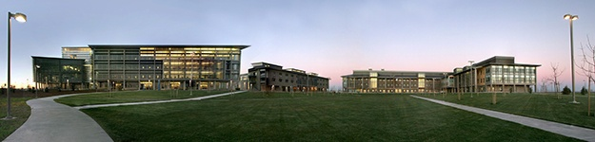
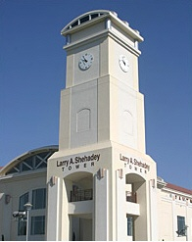
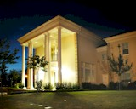

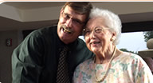
UC Merced
Fresno State
UC Office of the President
State Center Community Colleges
Mennonite Health Services

Slide 6
Trends
Decreasing state support
Lower state grants to students
Tuition increases
Increased fundraising
Online instruction
New alternatives in higher education

Slide 7
What impacts do we see?
Lower enrollments
Donor fatigue
Higher student debt
Working students
Leadership turnover
Advancement staff turnover

Slide 8
How are we responding?
Lobbying/Advocacy
Cuts in programs, staff and faculty
New efficiencies
Pressure to fundraise
Seek additional scholarship support
Increased communication

Slide 9
Lifesaving motto
Risk a little, save a little
Risk a lot, save a lot

Slide 10
Outside-In Mindset
More real involvement from people outside the university – donors, advocates
Set a compelling vision for outsiders
Develop close relationships with students and parents
A call to leadership
Applies to all advancement efforts – alumni, donors, advancement services, gov’t & community relations, stewardship.

Slide 11
Telling Your Story
Your university’s image is critical to your success
Enrollment
Major donor and foundation support
Alumni support
Government & community relations
Fundraising campaigns

Slide 12
Telling Your Story
Too often universities are forced to focus their leadership and advancement resources on the “crisis du jour.”
“Policy by press release”
Do you have an agenda or is your agenda being set for you?

Slide 13
Dynamic Environment
Leadership characteristics
Fundraising campaigns
Political & funding landscape
Interest groups
Impact of Web technologies
Growth pressures
Changing views of higher education & proprietary schools
Opportunity

Slide 14
Telling Your Story
Likely problem areas:
Athletics
Greeks
Legislators
Campus crime
Embezzlement
Leadership failures
Budgets
Data breach
Health services
Activists on campus
Fire/flood/calamity
Major events
Murphy’s Law

Slide 15
Telling Your Story
What are the big things people learned about your campus last year?
What are the big things people should learn about your campus this year?
How can you provide a more complete and accurate picture of your university?

Slide 16
Effective communications
The Secret…
Our communication is going to accomplish a specific goal and will express our moral purpose to our audiences.

Slide 17
Moral purpose
What gets you up in the morning?
What moral imperatives drive your university?
  Pioneering medical care
  Feeding the world
  Graduates with character who serve in the community

Slide 18
UC Irvine
Effective communications
That presumes there is an expected positive outcome from communication.
What outcome are you seeking?
What is the communication trying to accomplish?

Slide 19
UC Irvine
POSSIBLE OUTCOMES:
A “yes” vote on an upcoming proposition
Investor interest in a new venture
Donations
New memberships in the Alumni Association
Understanding for a controversial decision

Slide 20
Communications should always express the MORAL PURPOSE (AKA “the brand”) of the university.
What is “the brand?”
It’s not a slogan
It’s not a product
It’s not a logo

Slide 21
Brand is NOT a slogan
Save Money. Live Better.
I'm lovin’ it
The Power of Dreams
Imagination at Work
Get it right
Ingredients for Life
We Thought of Everything
Touching Life, Improving Lives
The Wind of Freedom Blows
Walmart
McDonalds
Honda
GE
H&R Block
Vons
Toshiba
P&G
Stanford

Slide 22
A College Brand is NOT a slogan
Grasp the forces driving the change.
I would found an institution where any person can find instruction in any study.
Numen Lumen
Advancing Knowledge. Transforming Lives.
Only at the U.
Always Thinking
Stanford
Cornell
Wisconsin
Michigan State
Minnesota
Univ. of Illinois

Slide 23








Columbia
Duke
Wisconsin
Harvard
Boston College
University of Michigan
San Jose State
Bakersfield College

Slide 24
Brand is…
Driving Performance
Safety
Creative Thinkers
Athletic Excellence
Family Entertainment
Status
Love
Free Speech
Conservative Thought
The Future
BMW
Volvo
Apple
Nike
Disney
Mercedes
DeBeers
UC Berkeley
Hoover Institute
UC Irvine

Slide 25
What is your college’s brand?
How would your alumni, students and faculty describe your moral purpose?
How do people “feel” about your campus?
What do people uniquely trust you to deliver?

Slide 26
Communications can be grouped into two categories:
On-going
Crisis
Both must always project and protect the brand:

Slide 27
If you’re not telling your story on an ongoing basis…
Someone else is!

Slide 28
If you’re not telling your story in a crisis…
Someone else is!

Slide 29

Ongoing Communications
All communications purposefully express the brand

Slide 30
Telling Your Story
Focus on strategic goals.
  Strategic plan summary
  Visionary leader
  Foundation vision
  Integrated marketing plan to advance strategic goals – with specific staff and funding

Slide 31
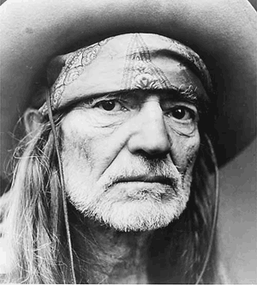
Maybe I didn't love you
Quite as often as I could have
And maybe I didn't treat you
Quite as good as I should have
If I made you feel second best
Girl, I'm sorry I was blind
But you were always on my mind
You were always on my mind
Maybe I didn't hold you
All those lonely, lonely times
And I guess I never told you
I'm so happy that you're mine
Little things I should have said and done
I just never took the time
You were always on my mind
You were always on my mind
Tell me
Tell me that your sweet love hasn't died
Give me
Give me one more chance to keep you satisfied
I'll keep you satisfied
Avoid the Willie Nelson Syndrome

Slide 32
Integrated Marketing
Aligns communications with the university’s critical goals
Defines and supports legitimate points of differentiation
Provides focus
Uses resources wisely
Like a musical score to an orchestra…it produces a symphony…not noise.

Slide 33

Ongoing Communications
You need a clear vision.
What are the values that set your college apart. Your brand permeates all facets of the college – academics, development, budget, communications, alumni, and athletics.

Slide 34


Slide 35

Ongoing Communications
It’s not just what we tell people we are…
It’s more about what they say we are as a result of their interaction with the college.
Outside in versus inside out.
Much of university communications and marketing can be like a bad date.

Slide 36
Bad donor relationships sound like…
“They just keep calling and calling…”
“It’s been a tough year for my business, but they keep asking for more…”
“They’re not listening to me…”
“I just throw their notes away”
“They won’t take no for an answer”

Slide 37
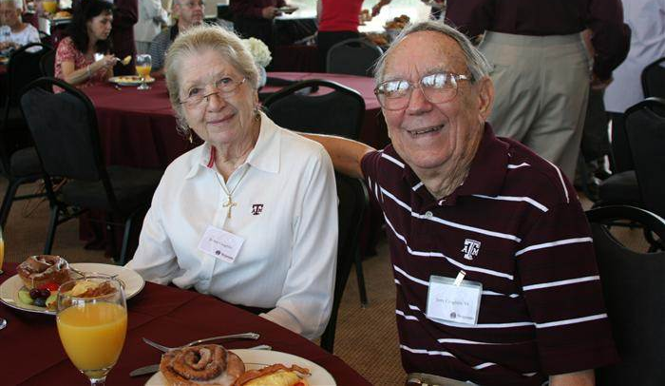
Ongoing Communications
Your college’s brand is about your relationship with the people who place their trust in you.
They are not customers, stakeholders and clients…rather they are partners, friends and colleagues.

Slide 38
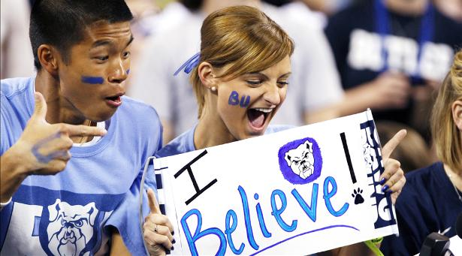
Ongoing Communications
It’s visceral…not just informational.
It’s more about emotion and feelings and less about information and facts.

Slide 39
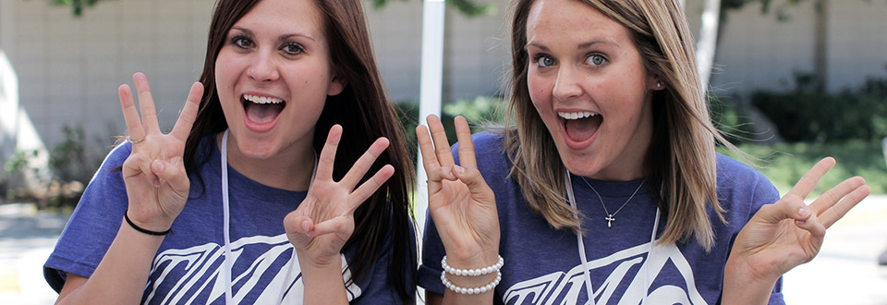
What are the top three unique values represented in your college’s brand?

Slide 40

What university do you identify as having a powerful brand?
What are the top three unique values or hallmarks that establish the brand of the university you select?

Slide 41


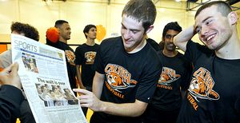
How do you present the values represented in your college’s brand?
Social media
Events
Donor relations
Public Affairs
Partnerships
Advertising

Slide 42
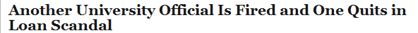
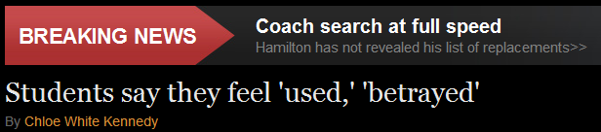
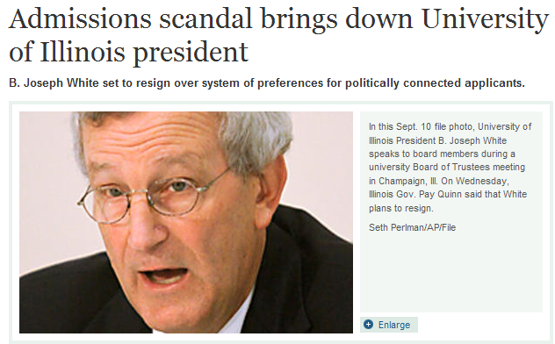
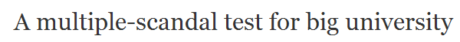
Telling Your Story
How do we provide a more complete and accurate picture of the university in a crisis?

Slide 43
Crisis Communications
In my career alone I’ve faced:
Automatic weapons fire on campus from fleeing bank robbers.
Student shoots and paralyzes professor.
Student commits suicide in a music studio.
Equestrian dies in riding accident.
Basketball star commits murder during a drug deal.
Embezzlement
Drunken frat party results in student death.
And more…

Slide 44
Crisis Communications
And what’s your story?

Slide 45
Crisis Communications
Leadership in a crisis is key:
What’s the ultimate solution to the problem? Focus on that, not on continuing to report the problems.
Respond…don’t react
Bad things will happen…be prepared…have a plan.
Understanding the crisis lifecycle
Context over content
Concentrate on rebuilding trust and reinforcing the brand

Slide 46
How are we perceived? | How do we want to be seen?
Crime-ridden and unsafe | A safe campus
Out-of-control athletics program – NCAA violations | Acknowledge past problems…now are in compliance
Students can’t afford to attend | New scholarships and student support in place
Rampant alcohol abuse by students | College offers alternatives for safer activities
Student protests put property at risk | Damaging property is at odds with our values
How you move from one column to the other is the start of your PLAN for communications

Slide 47
Telling Your Story
Current perception…
We want to move to…
Serious NCAA violations & booster dissatisfaction
Athletic Integrity
Public is unaware of
excellent medical programs
High awareness of medical programs
Campus reputation too dependent on athletic prowess
Academic program recognition

Slide 48
Telling Your Story
Create a communications group
  Respond to media inquiries and social media quickly
  Works from pre-set crisis communication plan
  Overall communications keeps on track with strategic goals
  Digital media has to be part of the group’s responsibility
  KEY: Effective communication is emotional rather than only fact-based

Slide 49
Crisis Communications
Reporters focus on the causes of a problem, who’s the victim, and who’s responsible.
As a leader you need to focus on solving problems.
What can I do personally to resolve the issue?
How can we team-up to fix the problem?
What’s the first step to fix this?
How can we reduce the impact and turn the situation around?

Slide 50
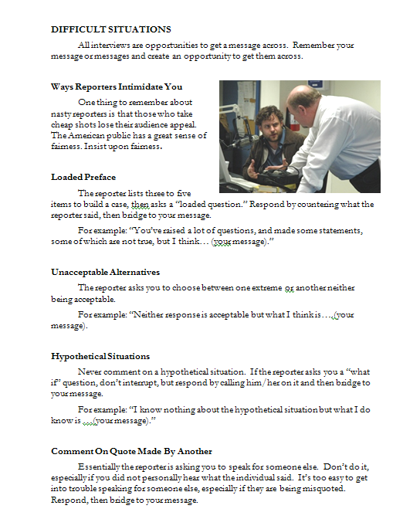
Crisis Communications
Mark Aydelotte at LinkedIn
There will be problems…have a plan.
Staff with specific responsibility for crisis communications (but don’t call them the ‘crisis communications team.’)
Tell it all, tell it fast and tell the truth

Slide 51
Thank You!
Additional resources at:
www.ValleyAlive.com/WACUBO
Mark Aydelotte on LinkedIn
or
maydelot@uci.edu

